Slide 1
Data Warehousing MLB Pitch Data
James Bloor
Summer 2 2022
CS779
Boston University MET

Slide 2
Project Topic
Sports Analytics
Data Availability
Pitch-by-pitch Data 2018
Notes:
Sports analytics is a world I want to enter over the next few years.
Most advanced sports data is behind a paywall, there so teams must pay for the data, like anything else.
Found a dataset on Kaggle with a few datasets that has great pitch by pitch data.
My goal: I want to create a dashboard that allows a user to filter a better’s results quickly and look at their performance overall and against certain pitchers.

Slide 3
Attributes of data
3 data files
Game
At Bat
Pitch
4 Key files
Player Name
Pitch Type
Pitch Result
Team Name
Notes:
Game: teams, score, location
At bat: batter, pitcher, inning, current score, result of the at bat
Pitch: type of ball thrown, count on the batter (balls/strikes), result of the pitch thrown
The key files help the abriviations in the 3 main data files

Slide 4
Business Questions
How did X team preform again X team in the 2018 season?
What are the most frequently throw pitches, pitch results, events for X player?
How does player X preform against pitcher X?
Notes:
My goal: I want to create a dashboard that allows a user to filter a better’s results quickly and look at their performance overall and against certain pitchers.
What are questions I would have as a decision maker in an MLB clubhouse

Slide 5
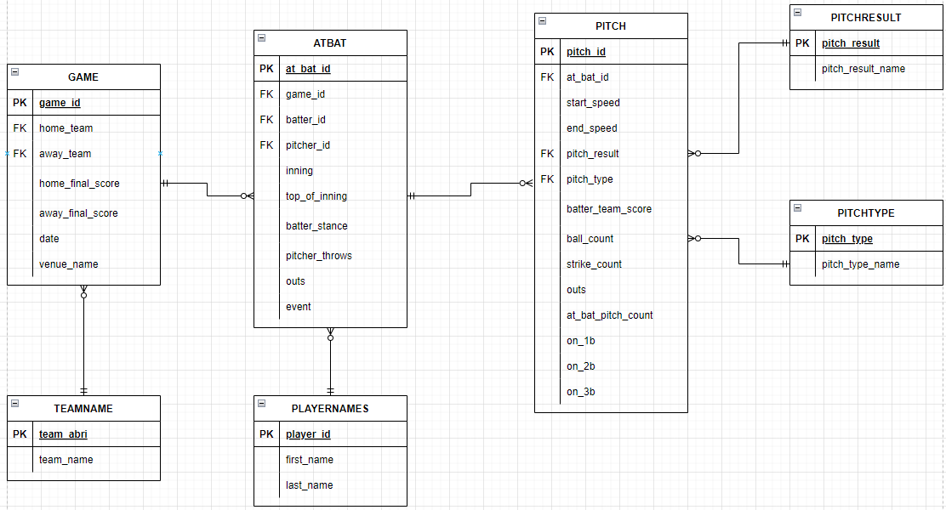
Relational Database ERD
Notes:
Explain the ERD
I did not normalize my tables because this is just a data warehouse I am creating, I am counting on the data to be collected at another location.

Slide 6
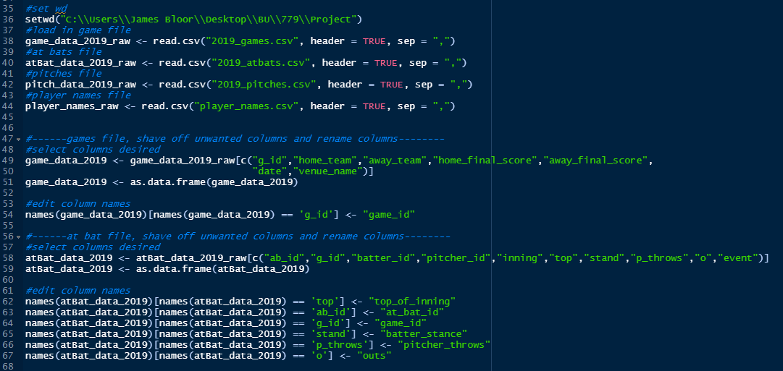
Pre-Processing
Notes:
Using R bc of familiarty for the pre processing data
Go through code

Slide 7
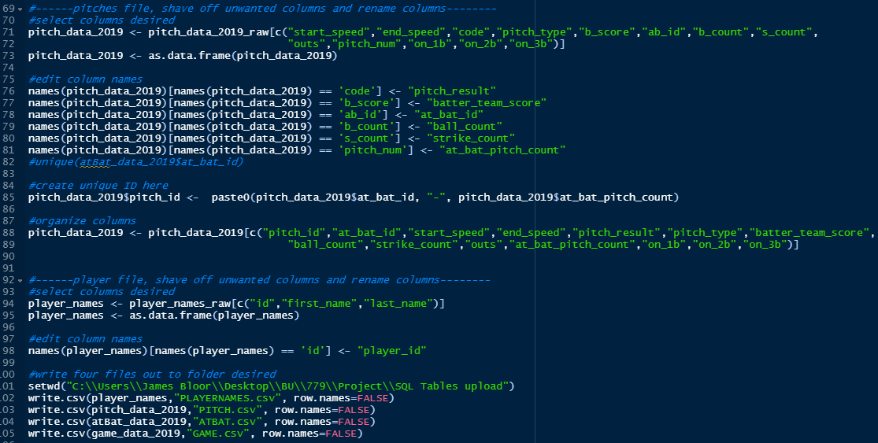
Pre-Processing (cont)

Slide 8
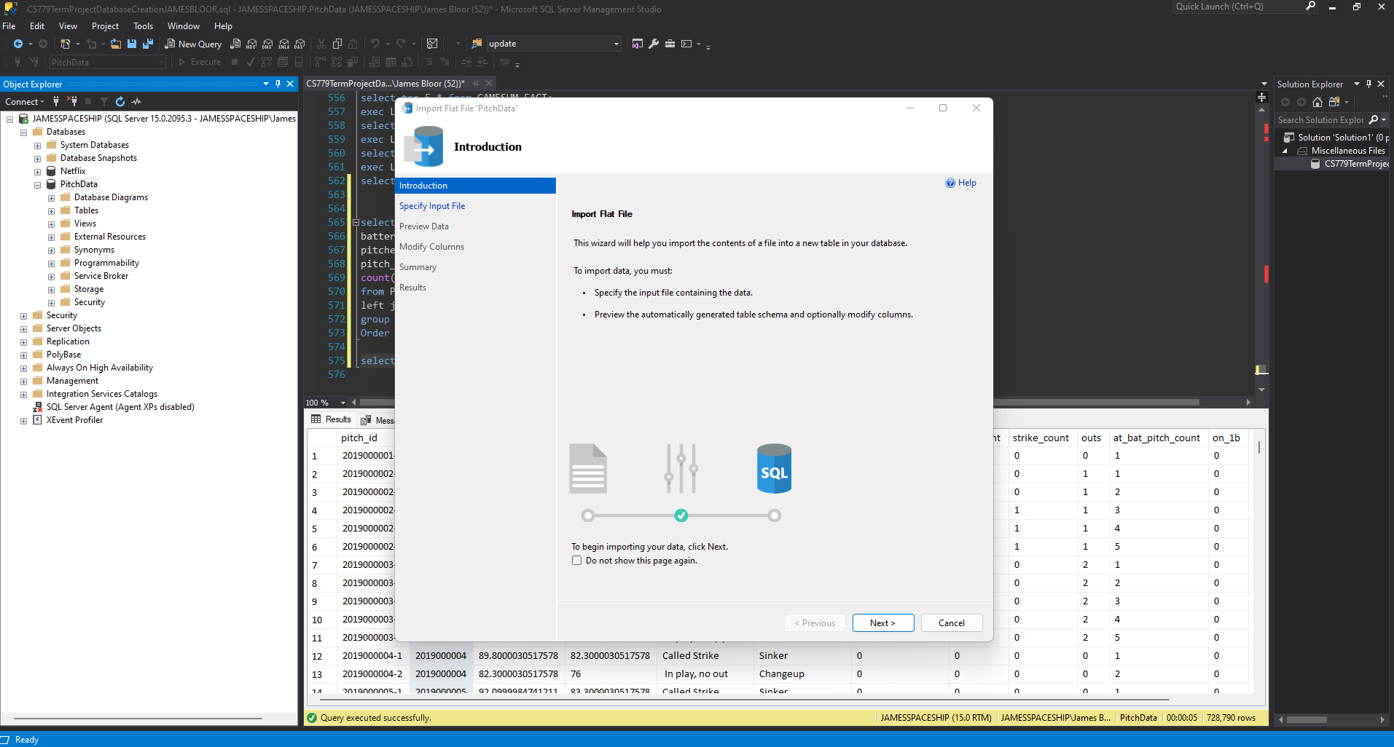
Load Data into MS SQL
Create Database
Stagging tables
Notes:
Show how to do in real life

Slide 9
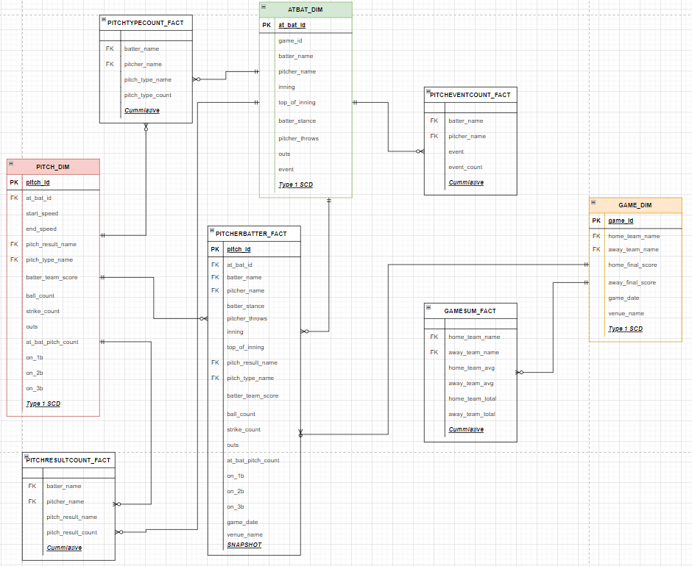
Data Warehouse Design
Notes:
These are my dimensional tables and fact tables

Slide 10
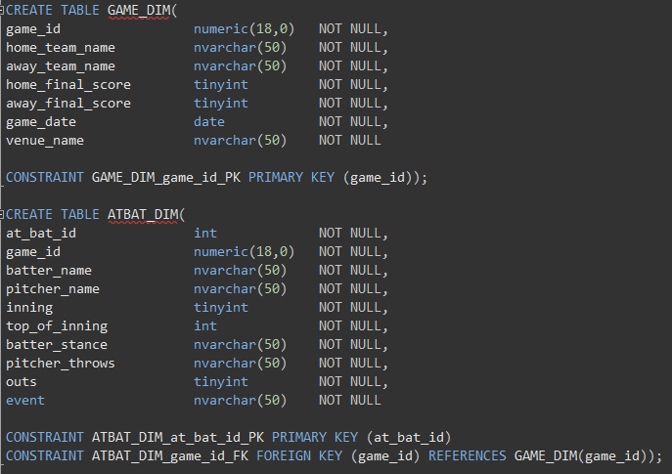
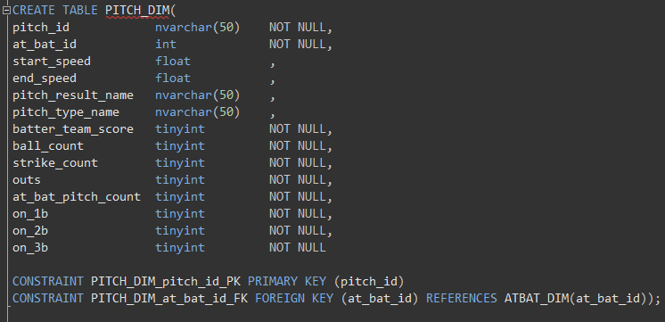
Dimensional Tables
Notes:
Let’s talk about dimensional tables created form our staging/importing tables

Slide 11
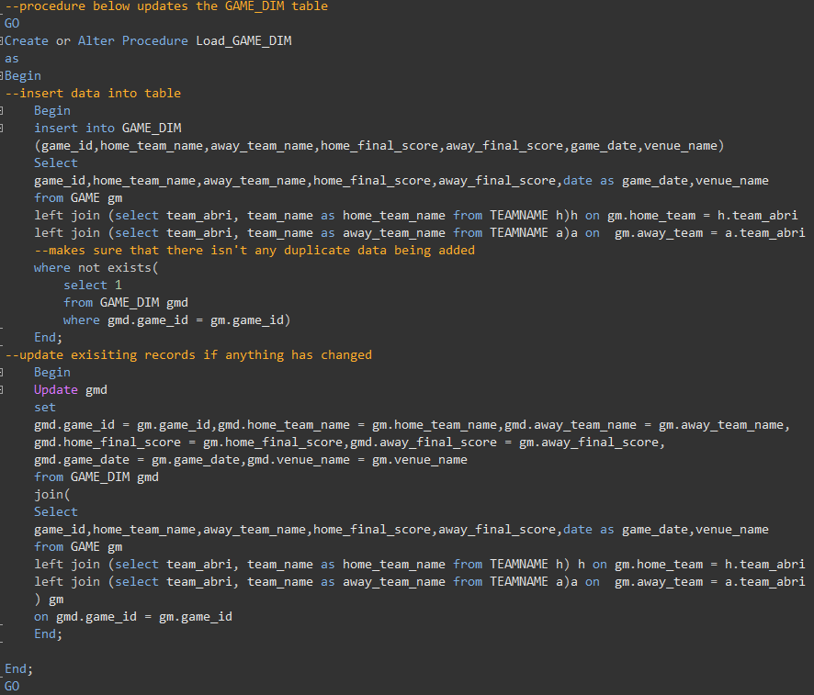
GAME_DIM
Notes:
Procedures to fill the dimensional tables from the stagging tables

Slide 12
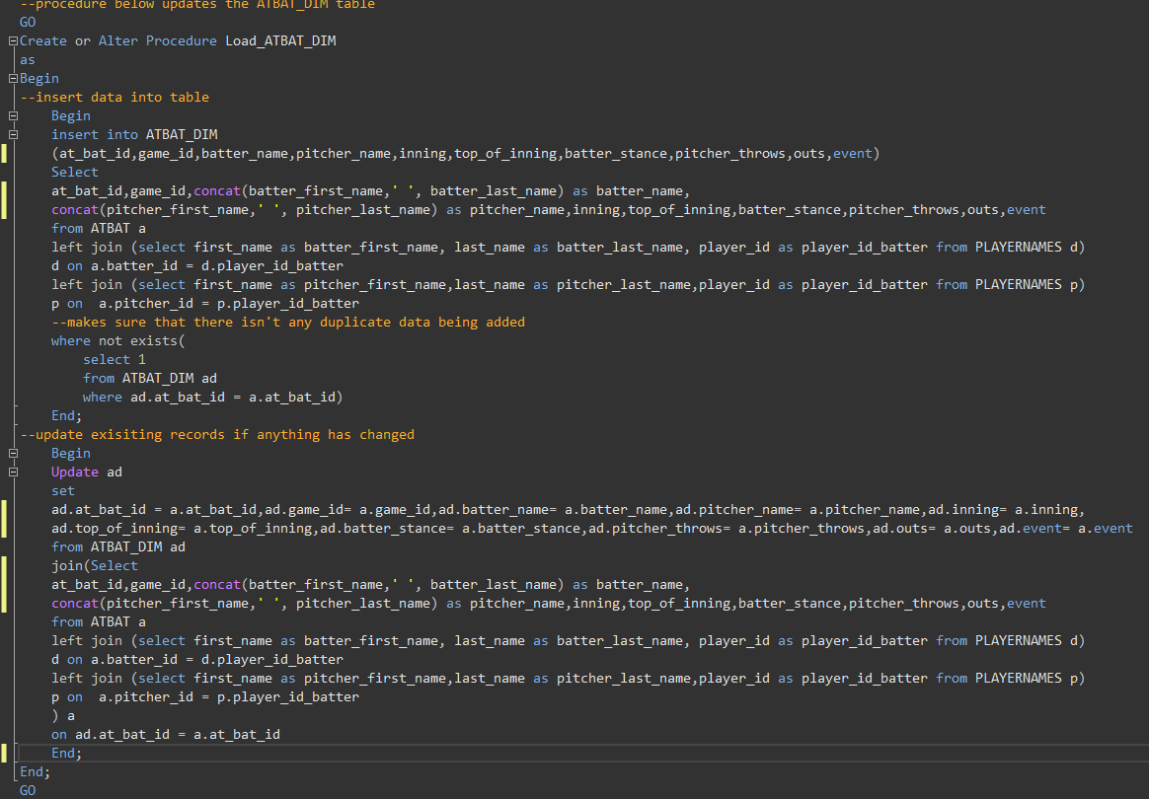
ATBAT_DIM
Notes:
Procedures to fill the dimensional tables from the stagging tables

Slide 13
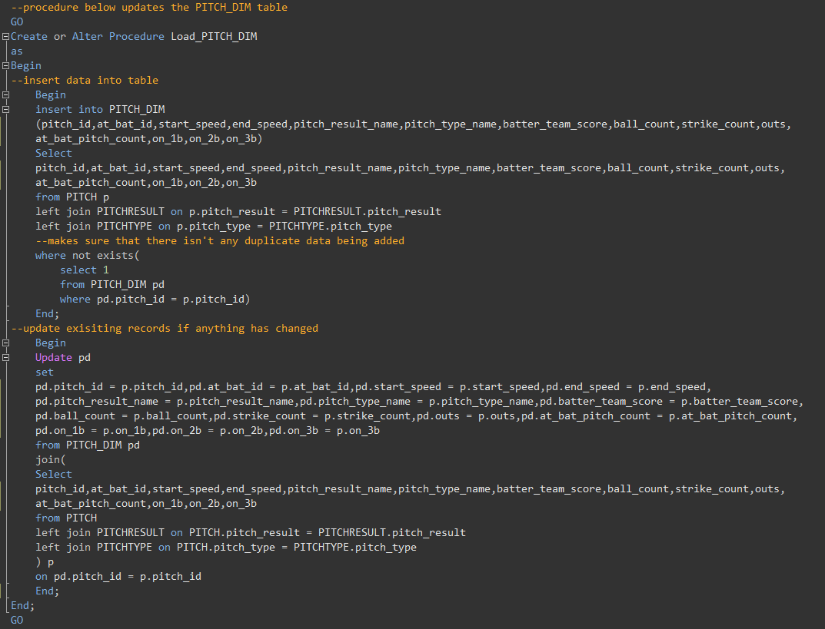
PITCH_DIM
Notes:
Procedures to fill the dimensional tables from the stagging tables

Slide 14
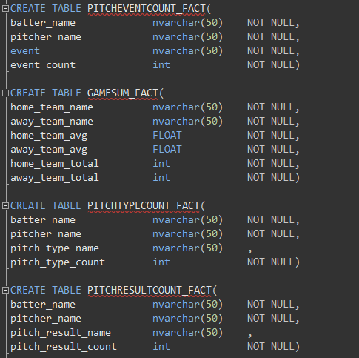
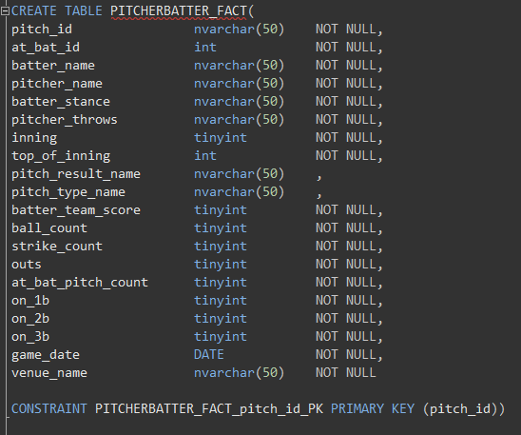
Fact Tables
Notes:
Creation of fact tables

Slide 15
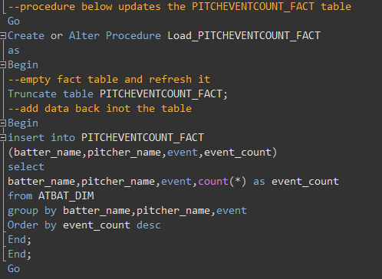
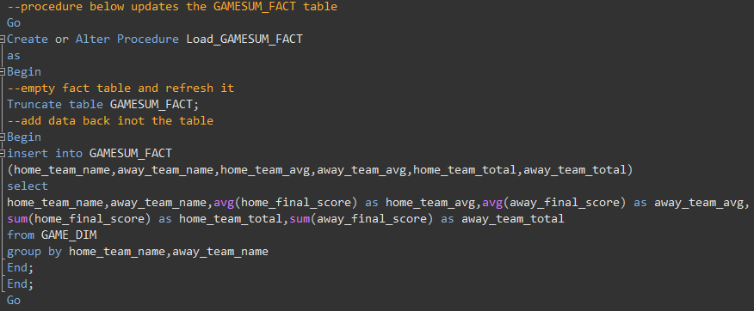
PITCHEVENTCOUNT_FACT & GAMESUM_FACT
Notes:
Procedures to fill the fact tables from the dim tables

Slide 16
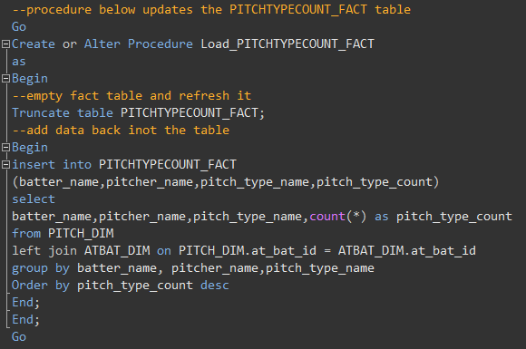
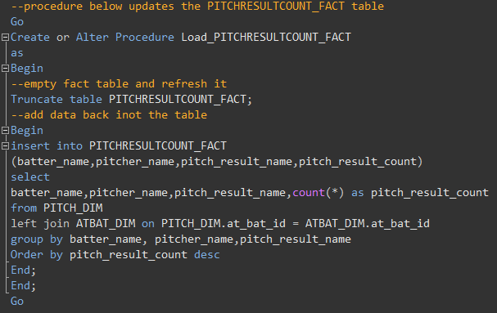
PITCHTYPECOUNT_FACT & PITCHRESULTCOUNT_FACT
Notes:
Procedures to fill the fact tables from the dim tables

Slide 17
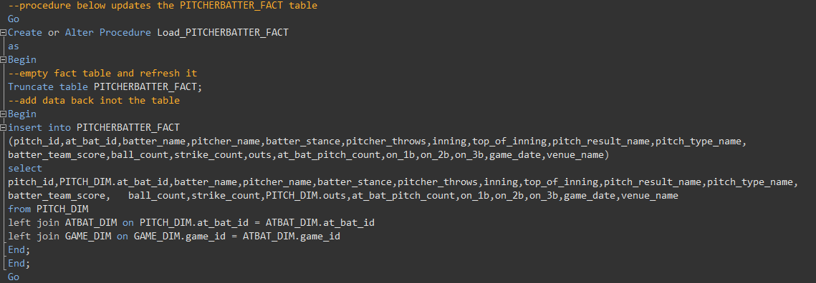
PITCHERBATTER_FACT
Notes:
Procedures to fill the fact tables from the dim tables

Slide 18
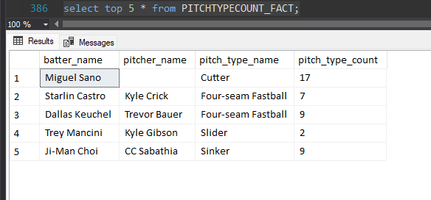
Realization of Data Issue
Not all the player IDs had a matching record in the player's name, file given with this data
Notes:
Just when everything was going smoothly… I see an irregularity in the select statement I was using to test my data.
After seeing this and going through my code to make sure I did not connect a player name incorrectly, I went to the raw data files. There are Player ids with no name in the player names file.
This is disappointing because there are about 9% of pitches that do not have a batter ID name match, and over 11% do not have the pitcher name.
Decided to move forward with my project and see how this effects my results.

Slide 19
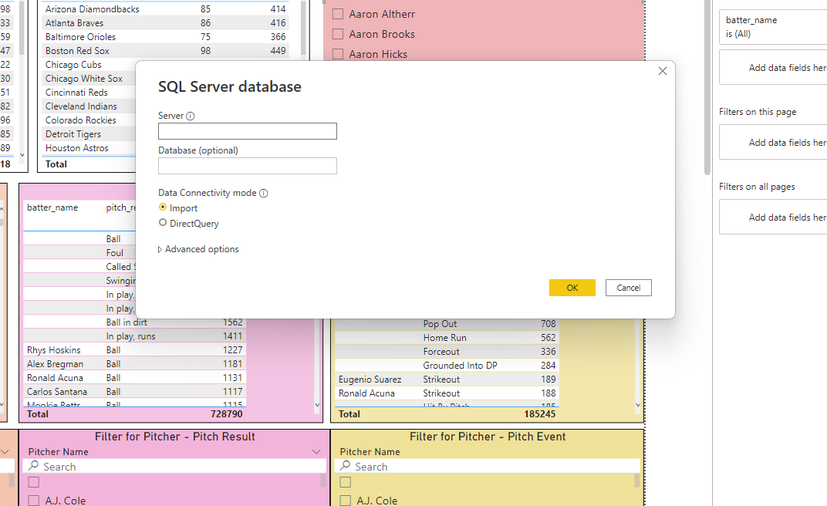
Load Data into Power BI
Notes:
I chose Power BI because I had never used it before and was encouraged to try a new dashboarding application by professor in a lecture. User friendly when loading data, all it took was inputting my server, database, and seelcing the files I wanted to use in power BI
Show how to do in real life

Slide 20
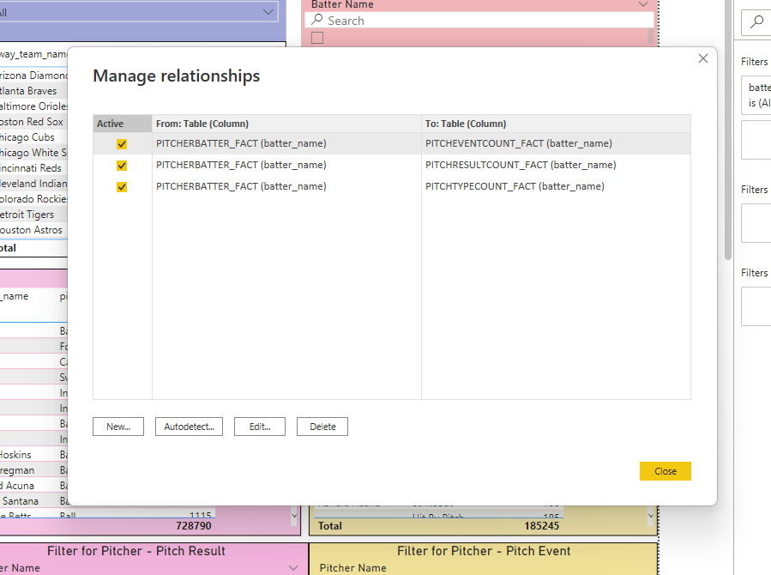
Creating Relationships
Notes:
When bringing these files into power bi they do not have the relationships between each other so we must create them
These relationships allow us to filter/slice multiple tables all at once.
By default, Power BI will only allow one active connection between tables.
Show how to do in real life

Slide 21
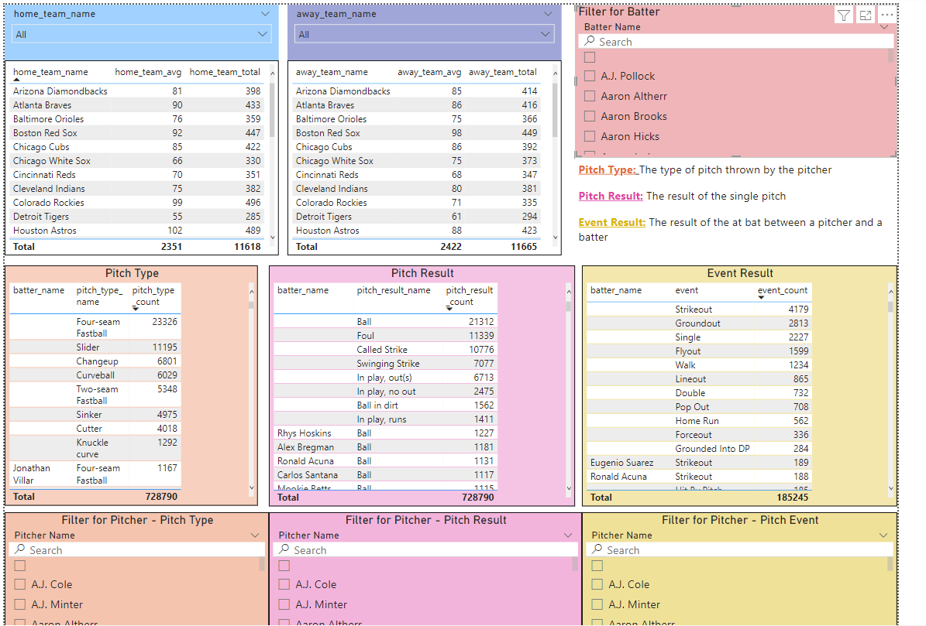
Dashboard
Notes:
Show how to do in real life

Slide 22
Takeaways
Streamlined process utilizing SQL is user friendly for various level of SQL familiarity
Consistent data checks are necessary at all stages of Data warehousing
Future updates: determining the player's name from player ID using another dataset/at bat file

Slide 23
References
Schale, P. (2020, May 17). MLB Pitch Data 2015-2018. Kaggle. Retrieved August 15, 2022, from https://www.kaggle.com/datasets/pschale/mlb-pitch- data-20152018?resource=download
YouTube. (2021). Data Warehouse - 11 - Load Dim Tables using Stored Proc. YouTube. Retrieved August 10, 2022, from https://www.youtube.com/watch?v=urLBGp3_3PY.
YouTube. (2020). How to connect Power Bi with Sql and build an Automated Dashboard [Sql to Power Bi]. YouTube. Retrieved August 10, 2022, from https://www.youtube.com/watch?v=WgE8pVLgWGs.

